Slide 1
COMBINATIONAL LOGIC
Combinational Circuits;
Analysis Procedure;
Design Procedure;
Adders; Subtractors

Slide 2
INTRODUCTION
Logic circuits for digital systems may be combinational or sequential.
A combinational circuit consists of logic gates whose outputs at any time are determined from only the present combination of inputs.
A combinational circuit performs an operation that can be specified logically by a set of Boolean functions.

Slide 3
In contrast, sequential circuits employ storage elements in addition to logic gates.
Their outputs are a function of the inputs and the state of the storage elements.
Because the state of the storage elements is a function of previous inputs, the outputs of a sequential circuit depend not only on present values of inputs, but also on past inputs, and the circuit behavior must be specified by a time sequence of inputs and internal states.

Slide 4
COMBINATIONAL CIRCUITS
A combinational circuit consists of an interconnection of logic gates.
Combinational logic gates react to the values of the signals at their inputs and produce the value of the output signal, transforming binary information from the given input data to a required output data.
A block diagram of a combinational circuit is shown in Fig.

Slide 5
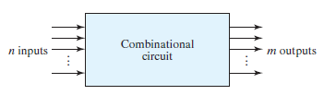
The n input binary variables come from an external source; the m output variables are produced by the internal combinational logic circuit and go to an external destination.
Each input and output variable exists physically as an analog signal whose values are interpreted to be a binary signal that represents logic 1 and logic 0.

Slide 6
For n input variables, there are 2^{n} possible combinations of the binary inputs.
For each possible input combination, there is one possible value for each output variable.
Thus, a combinational circuit can be specified with a truth table that lists the output values for each combination of input variables.
A combinational circuit also can be described by m Boolean functions, one for each output variable. Each output function is expressed in terms of the n input variables.

Slide 7
ANALYSIS PROCEDURE
The analysis of a combinational circuit requires that we determine the function that the circuit implements.
This task starts with a given logic diagram and culminates with a set of Boolean functions, a truth table, or possibly, an explanation of the circuit operation.

Slide 8
DESIGN PROCEDURE
The procedure involves the following steps:
From the specifications of the circuit, determine the required number of inputs and outputs and assign a symbol to each.
Derive the truth table that defines the required relationship between inputs and outputs.
Obtain the simplified Boolean functions for each output as a function of the input variables.
Draw the logic diagram and verify the correctness of the design (manually or by simulation).

Slide 9
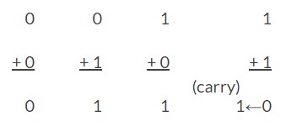
ADDERS
The most basic arithmetic operation is the addition of two binary bits.
This simple addition consists of 4 possible operations, namely,

Slide 10
Half Adder
A combinational circuit that performs the addition of two bits is called a half adder.
A half adder is a combinational circuit with two binary inputs (augend and addend bits) and two binary outputs (sum and carry bits).
It adds the two inputs (A and B) and produces two outputs, sum (S) and carry (C).

Slide 11
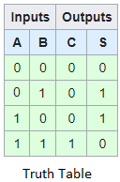
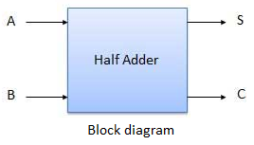
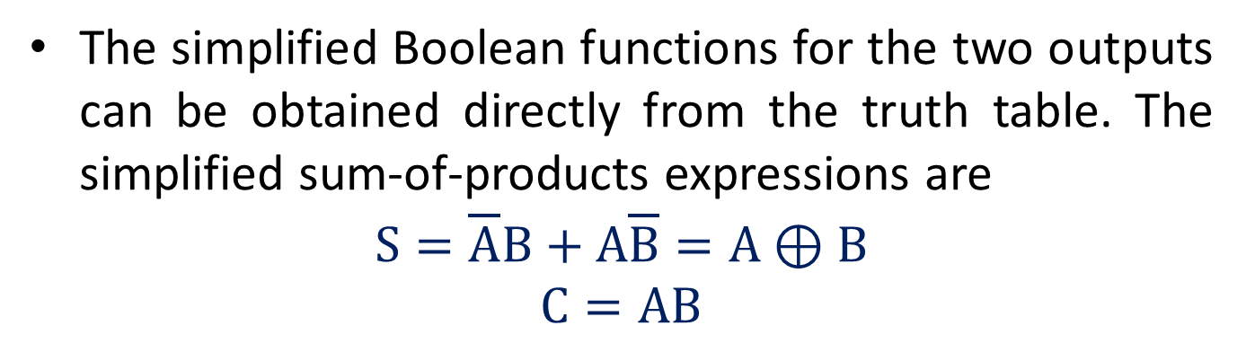
The simplified Boolean functions for the two outputs can be obtained directly from the truth table. The simplified sum-of-products expressions are
$$S=\overline{A}B+A\overline{B}=A⊕B$$
$$C=AB$$

Slide 12
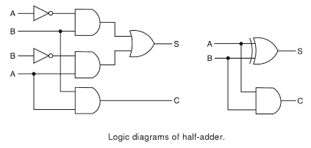

Slide 13
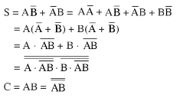
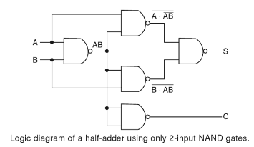
Implementation of half adder by using only NAND gates.

Slide 14
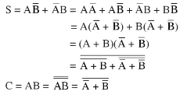
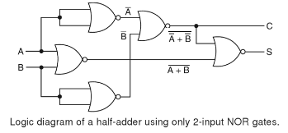
Implementation of half adder by using only NOR gates.

Slide 15
Full Adder
A full adder is a combinational circuit that forms the arithmetic sum of three bits (two significant bits and a previous carry).
It consists of three inputs and two outputs.
The full adder adds the bits A and B and the carry from the previous column called the carry-in C_{in} and outputs the sum bit S and the carry bit called the carry-out C_{out}.

Slide 16
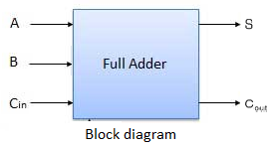
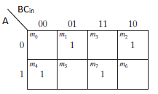
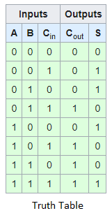
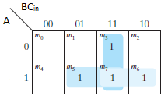


The simplified expressions are
$$S=∑(1, 2, 4, 7)$$
$$Cout=∑(3, 5, 6, 7)$$

Slide 17
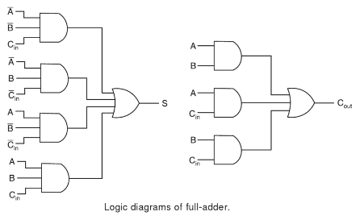

Slide 18


Implementation of full adder with two half adders and an OR gate.
From the truth table of full adder, the outputs sum and carry are described by
and

Slide 19
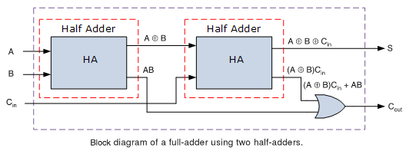
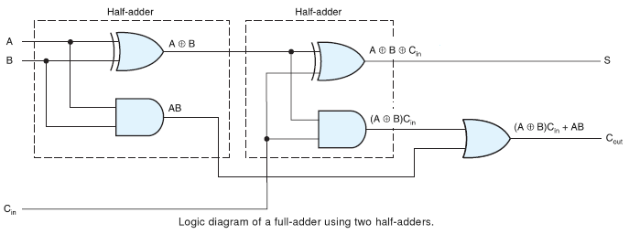

Slide 20
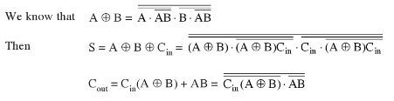
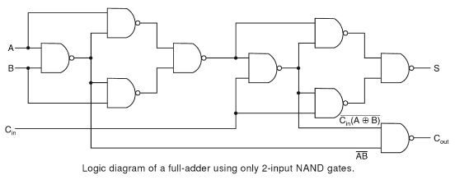
Implementation of full adder by using only NAND gates.

Slide 21
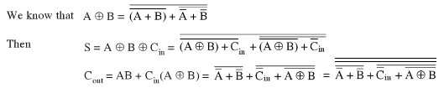
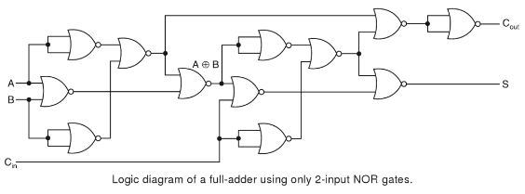
Implementation of full adder by using only NOR gates.

Slide 22
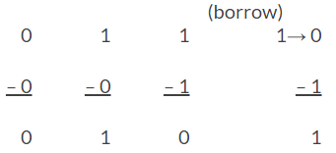
Subtractors
In subtraction, each subtrahend bit of the number is subtracted from its corresponding significant minuend bit to form a difference bit.
If the minuend bit is smaller than the subtrahend bit, a 1 is borrowed from the next significant position.

Slide 23
Half Subtractor
A half subtractor is a combinational circuit that subtracts one bit from the other and produces the difference. It also has an output to specify if a 1 has been borrowed.
It is used to subtract the LSB of the subtrahend from the LSB of the minuend when one binary number is subtracted from the other.
A half subtractor is a combinational circuit with two inputs A and B and two outputs d and b, d indicates the difference and b is the output signal generated that informs the next stage that a 1 has been borrowed.

Slide 24
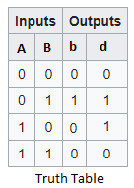
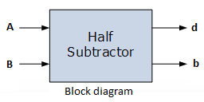
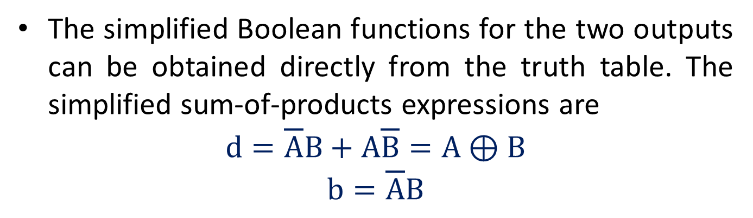
The simplified Boolean functions for the two outputs can be obtained directly from the truth table. The simplified sum-of-products expressions are
$$d=\overline{A}B+A\overline{B}=A⊕B$$
$$b=\overline{A}B$$

Slide 25
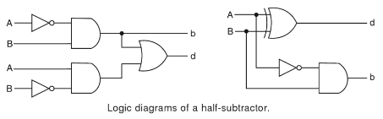

Slide 26

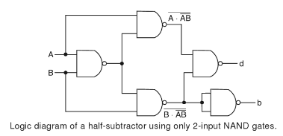
Implementation of half subtractor by using only NAND gates.

Slide 27

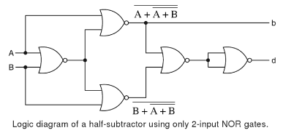
Implementation of half subtractor by using only NOR gates.

Slide 28
Full Subtractor
The full subtractor is a combinational circuit which is used to perform subtraction of three input bits.
It subtracts one bit from another bit, when already there is a borrow from this column for the subtraction in the preceding column, and outputs the difference bit and the borrow bit required from the next column.
So a full subtractor is a combinational circuit with three inputs (A, B, b_{i}) and two outputs d and b. The two outputs present the difference and output borrow.

Slide 29
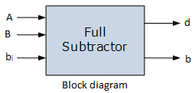
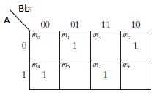
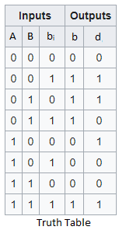
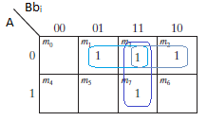


The simplified expressions are
$$d=∑(1, 2, 4, 7)$$
$$b=∑(1, 2, 3, 7)$$

Slide 30
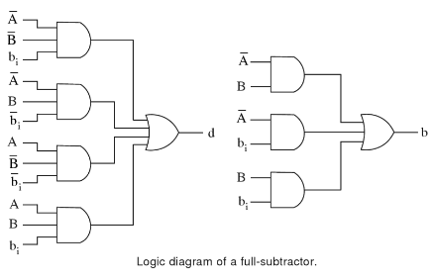

Slide 31


Implementation of full subtractor with two half subtractors and an OR gate.
From the truth table of full adder, the outputs difference and borrow are described by
and

Slide 32
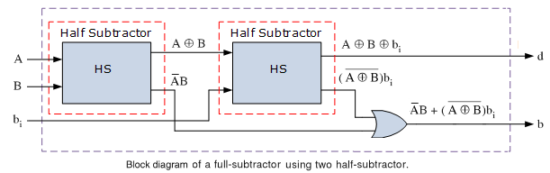
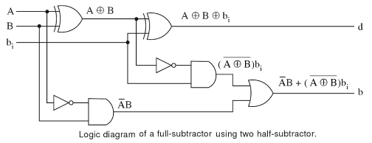

Slide 33
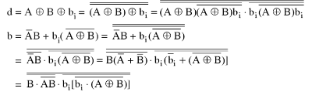
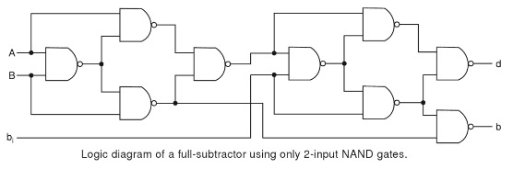
Implementation of full subtractor by using only NAND gates.

Slide 34
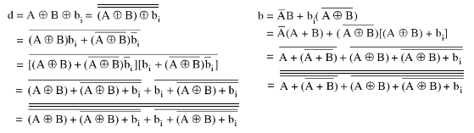
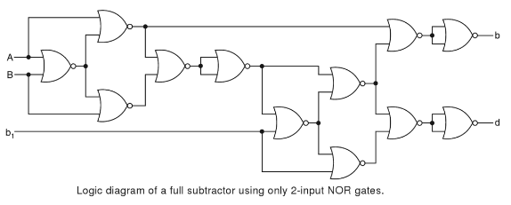
Implementation of full subtractor by using only NOR gates.

